Slide 1

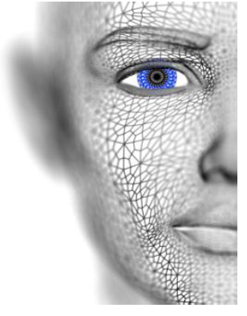
University of Missouri-Columbia - College of Engineering – Electrical Engineering and Computer Science Dept.
Localized Deep Learning Structure for The Large-Scale Biometric Data Recognition
PhD Candidate EECS
Adil Al-Azzawi
Adil Al-Azzawi

Slide 2
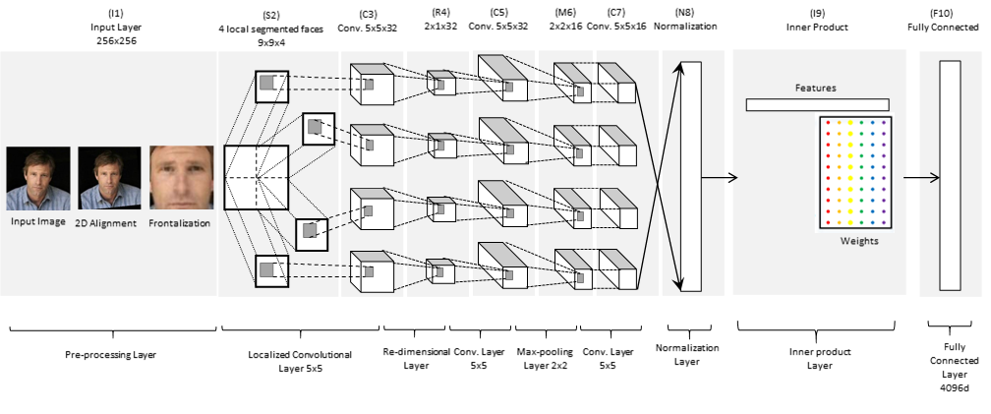
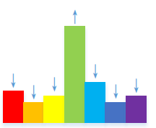
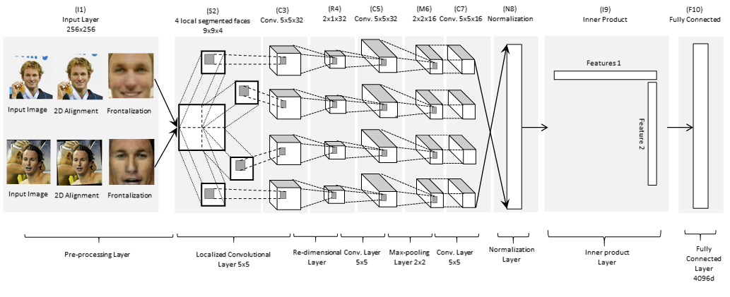
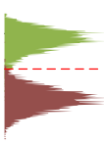
Localized Deep Face Model
Reconstruction our Model
Training
Classification
Layer
Same Identity
Testing
Different Identity
Thresholding
Layer
Adil Al-Azzawi

Slide 3
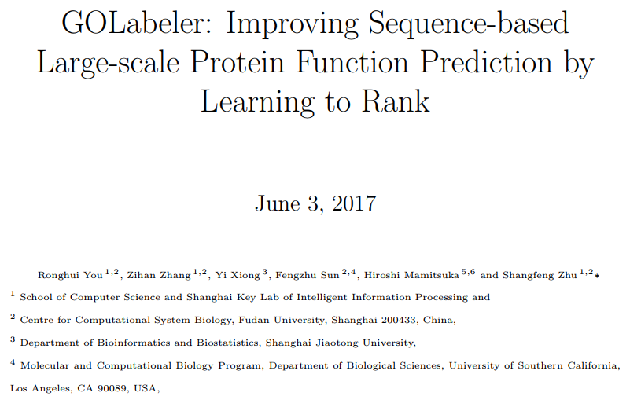
Protein Function Prediction
Adil Al-Azzawi

Slide 4
Protein Function Prediction
Motivation
Gene Ontology (GO) has been widely used to annotate functions of proteins and understand their biological roles.
GO has more than 40,000 biological concepts over three domains: Molecular Function Ontology (MFO), Biological Process Ontology (BPO) and Cellular Component Ontology (CCO).
Currently only 1% of more than 70 million proteins in UniProtKB have experimental GO annotation which is strong necessity of Automated Function Prediction (AFP).
Obviously in practice majority (around 99% or more) of proteins have only sequences, meaning that AFP for no-knowledge proteins would be more important.
Experimental information, such as protein-protein interactions, are more costly than sequencing, resulting in literally limited knowledge (vastly missing information) among the large-scale data of AFP.
The sequence-based AFP is important and should be tackled first Protein-protein interactions, are more costly than sequencing, Also sequences are less noisy than experimental data
Adil Al-Azzawi

Slide 5
Protein Function Prediction
Problem and Challenges
AFP is a large-scale multi-label classification problem due to one protein with a diverse number of GO terms.
One GO term as a class label and also one protein as an instance with multiple labels (multiple GO terms).
Most of these proteins have only sequences as input information, indicating the importance of sequence-based AFP (SAFP: sequences are the only input).
AFP is very challenging due to:
Structured Ontology: GO terms are node labels of a directed acyclic graph (DAG), by which one gene annotated at one node must be labeled by GO terms of all ancestor nodes in the DAG.
Many labels per protein: 66,841 proteins and found that a human protein is labeled by around 71 GO terms on average;
Large variation in the number of GO terms per protein: 634, out of all 10,236 GO terms in MFO (GO Ontology in Jun 2016), are associated with more than 50 proteins.
Adil Al-Azzawi

Slide 6
Protein Function Prediction
Problem and Challenges
A target protein is called a limited-knowledge protein, if it has experimental annotation in another domain; otherwise, it is called a no-knowledge protein.
The no-knowledge benchmark can be divided into two types (according to the largest global sequence identity of the corresponding sequence to any other sequences in the training data).
Difficult, includes those with the largest sequence identity of less than 60%, otherwise they are called Easy.
Goal:
Instead of relying on sequence homology only, to develop an approach which can predict the function of the difficult type of proteins within the scope of sequence-based approach.
Collect not only homology-related information but also various types of information available from sequences as diverse as possible and develop a method which can integrate all of these information effectively and efficiently.
Adil Al-Azzawi

Slide 7
Protein Function Prediction
Proposed Methods:
From Protein Sequence to Protein Function via Multi-Label Linear Discriminant Analysis.
Hua Wang, Lin Yan, Heng Huang, and Chris Ding, IEEE/ACM TRANSACTIONS ON COMPUTATIONAL BIOLOGYAND BIOINFORMATICS, VOL. 14, NO. 3, MAY/JUNE 2017
A Generative Model with Hypergraph Regularizers for Protein Function Prediction,
Shaokai Wang, Xutao Li, Yunming Ye, 2016 IEEE International Transection on Bioinformatics and Biomedicine (BIBM)
Protein Expression Data Improves Gene Function Prediction
Huadong Yang, Xiaofeng Song, 2016 IEEE International Conference on Bioinformatics and Biomedicine (BIBM)
Inferring the Functions of Proteins from the Interrelationships between Functional Categories
Kamal Taha, Senior Member, IEEE, IEEE/ACM Transactions on Computational Biology and Bioinformatics
GOLabeler: Improving Sequence-based Large-scale Protein Function Prediction by Learning to Rank
Adil Al-Azzawi

Slide 8
Protein Function Prediction
Based Method (LTR and AFP)
LTR is useful for multi-label classification, where multiple labels can be assigned to one instance(by ranking labels and choosing top of them).
AFP, currently GO terms for one protein are not ranked, while they can be ranked by some nature behind GO terms, such as if they are major or minor
Main Advantages (Why using LTR?)
LTR is already currently useful as a tool for multi-label classification and also very promising for the future AFP.
LTR is that GOLabeler can integrate multiple sequence-based evidence effectively, which are generated by different types of classifiers (or components), where all information are derived from the sequences only.
This feature makes GOLabeler predict the functions of proteins having sequences with global sequences identity of less than 60% (difficult proteins) better than homology-based methods reasonably.
Adil Al-Azzawi

Slide 9


Protein Function Prediction
GOLabeler (Approach Method)
Step 1: Generate candidates GO terms
In testing, given the sequence of a query protein, candidate GO terms are generated from five components, which are already trained by using different types of information.
Step 2: Generate features for ranking GO terms
Each candidate GO term receives prediction scores from the five components, resulting in a feature vector of length five. Then candidate GO terms (feature vectors) are put into the (LTR)
Step 3: Rank GO terms by learning to rank (LTR)
LTR model is already trained by using training data, and finally, a ranked list of GO terms is returned as the final output of GOLabeler.
Components
Naive: GO term frequency
BLAST-KNN (B-K): sequence alignment
LR-3mer: amino acid trigram : use the frequency of three consecutive amino acids
LR-InterPro: protein families, domains and motifs: combines 14 different protein and domain family dataset
LR-ProFET: sequence features including biophysical properties
Adil Al-Azzawi

Slide 10
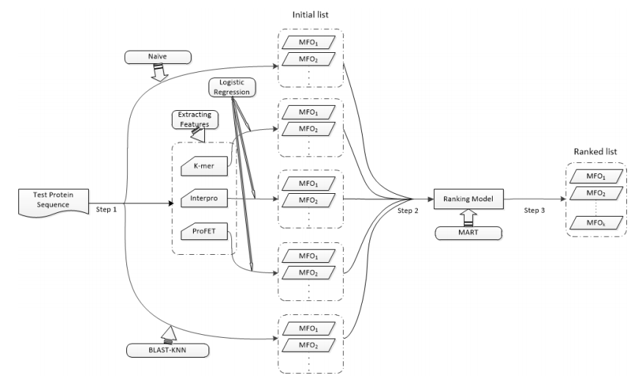
Protein Function Prediction
GOLabeler (Framework)
Adil Al-Azzawi

Slide 11
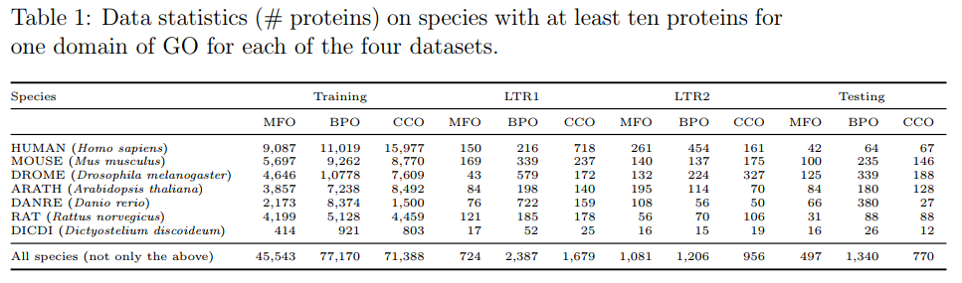
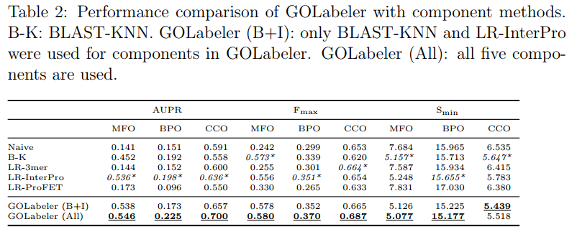
Protein Function Prediction
Dataset
Training: all in 2014
Training LTR: all in 2015 (no-knowledge)
Training LRT2: all in 2015 (limit-knowledge)
Testing: in 2016
Performance
Adil Al-Azzawi

Slide 12
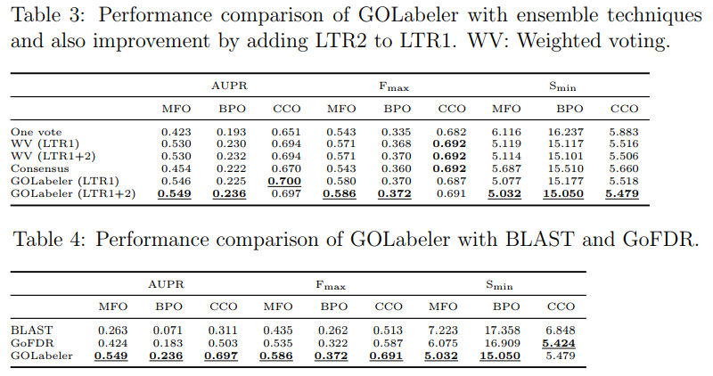
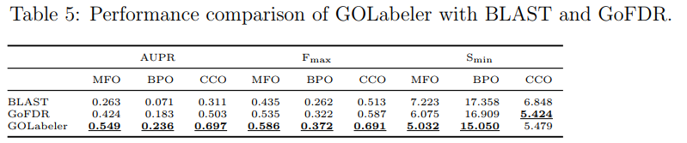
Protein Function Prediction
Performance
Adil Al-Azzawi

Slide 13
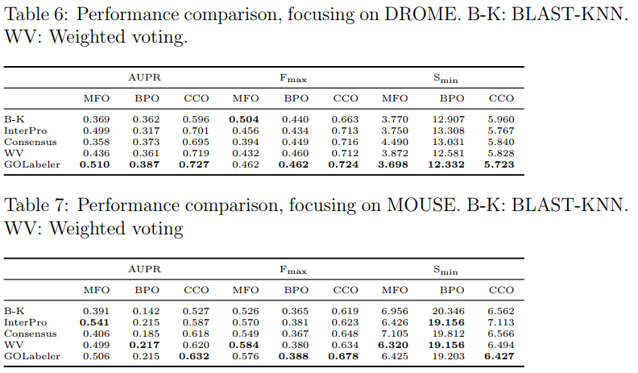
Protein Function Prediction
Performance
Adil Al-Azzawi

